Slide 1
Changing Brains Law & Neuroscience Course Duquesne University 9 April 2019
Adam Thomas
Data Science and Sharing Team, FMRIF, NIMH
http://cmn.nimh.nih.gov/dsst
adamt@nih.gov Slides available online: https://github.com/agt24

Slide 2
Outline
Why do you have a brain?
Can we change (fix) a brain?
How will we fix brains in the future?

Slide 3
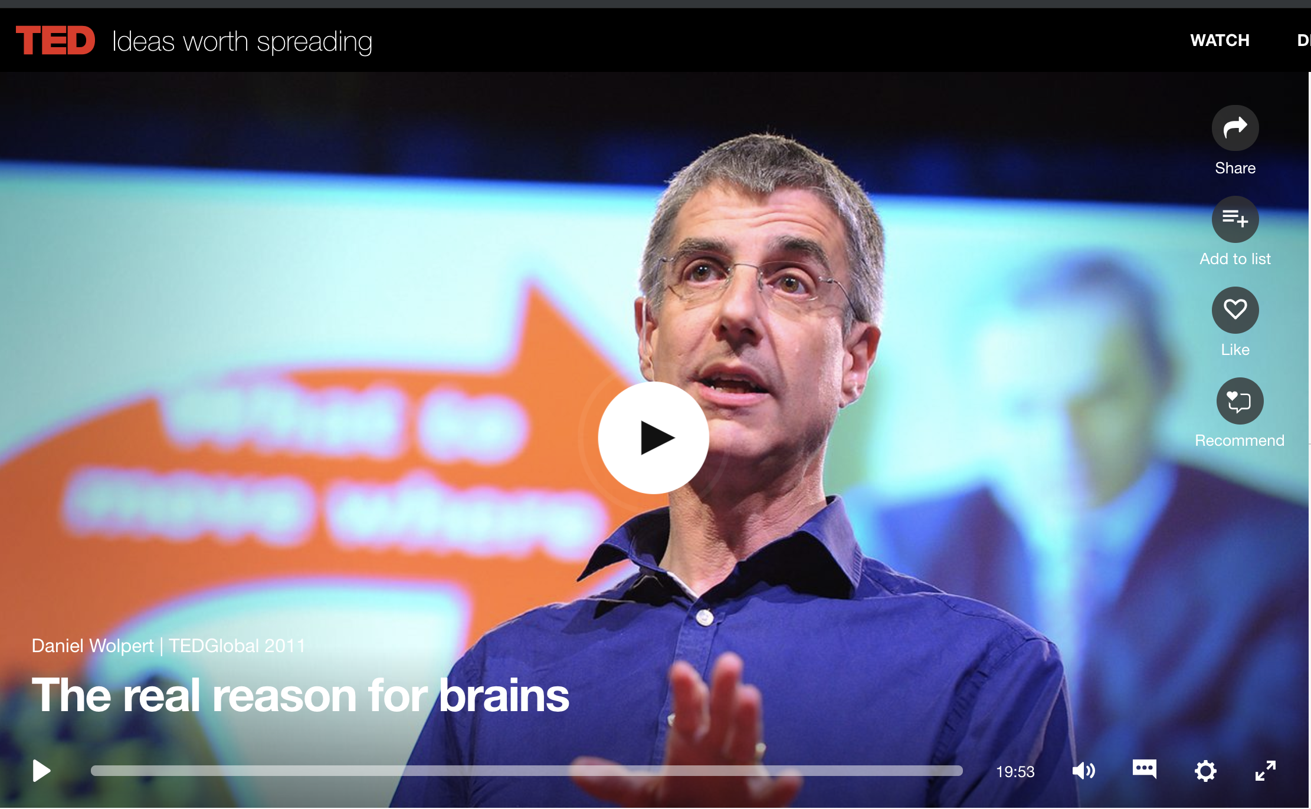
Why do you have a brain?
https://www.ted.com/talks/daniel_wolpert_the_real_reason_for_brains
Notes:
This stuff is really important and super boring. It’s not what you got a PhD for and we can help you.

Slide 4
Why do you have a brain?
“We have a brain for one reason and one reason only — and that's to produce adaptable and complex movements.”

Slide 5
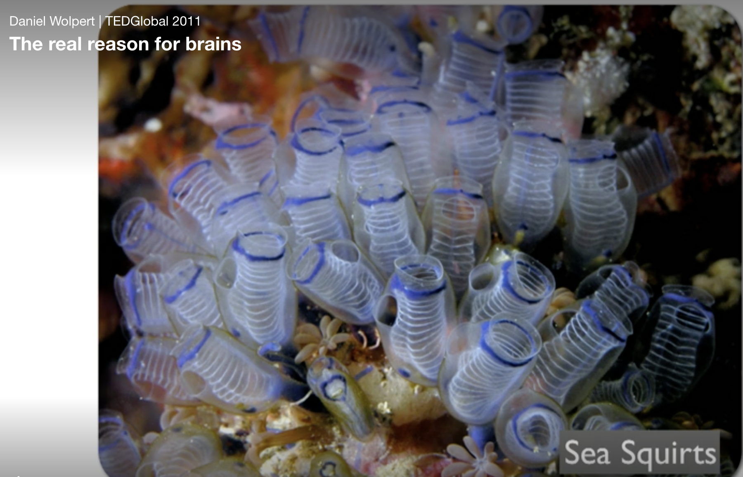
Why do you have a brain?
https://www.ted.com/talks/daniel_wolpert_the_real_reason_for_brains
Notes:
This stuff is really important and super boring. It’s not what you got a PhD for and we can help you.

Slide 6
Why do you have a brain?
“We have a brain for one reason and one reason only — and that's to produce adaptable and complex movements. Movement is the only way you have of affecting the world around you.

Slide 7
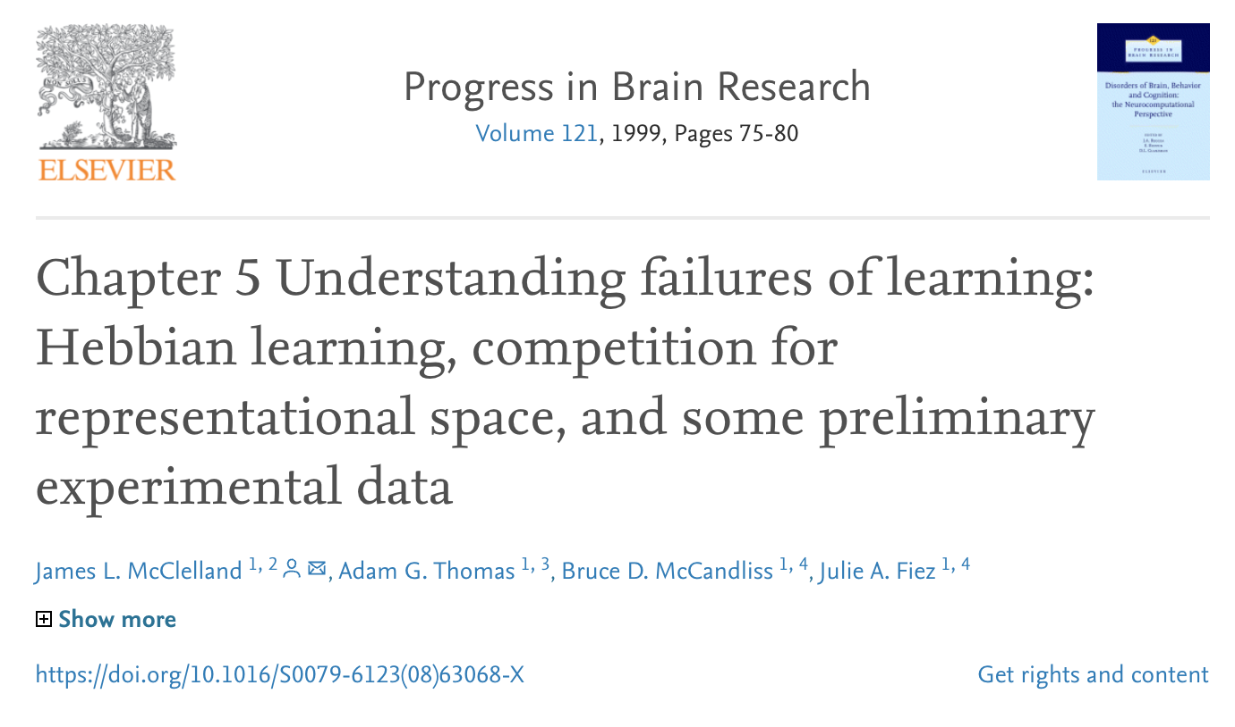
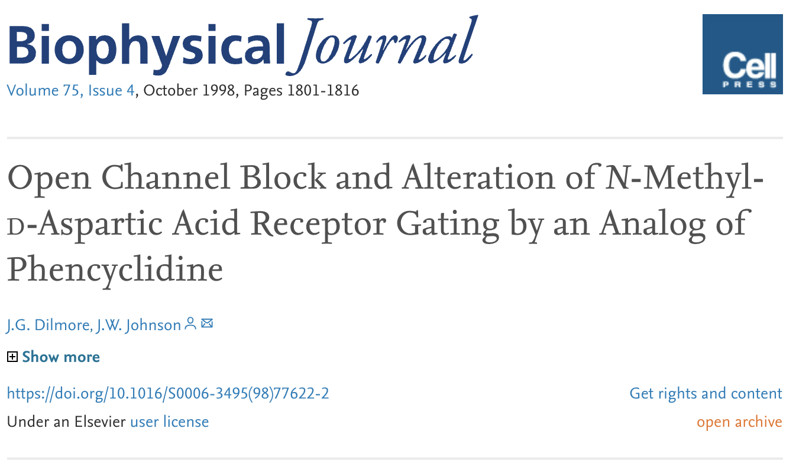
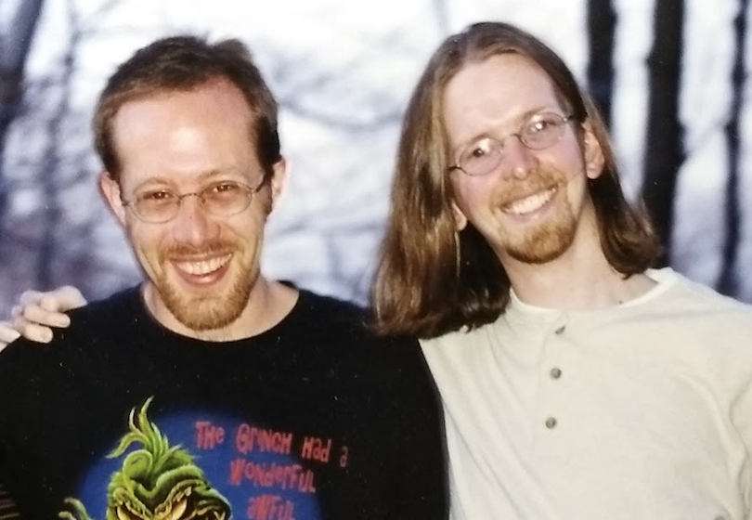
Brain Plasticity is cool!
In the late 1990s Prof. Dilmore and I both studied “brain plasticity” at the University of Pittsburgh
Notes:
This stuff is really important and super boring. It’s not what you got a PhD for and we can help you.

Slide 8
Outline
Why do you have a brain?
Adaptable and complex movements
The brain is the best learning machine we know of

Slide 9
Outline
Why do you have a brain?
Adaptable and complex movements
The brain is the best learning machine we know of
Can we change (fix) a brain?
How will we fix brains in the future?

Slide 10
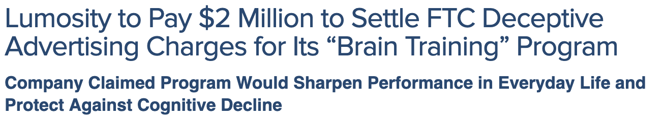

Can we change brains? Brain Training

Slide 11
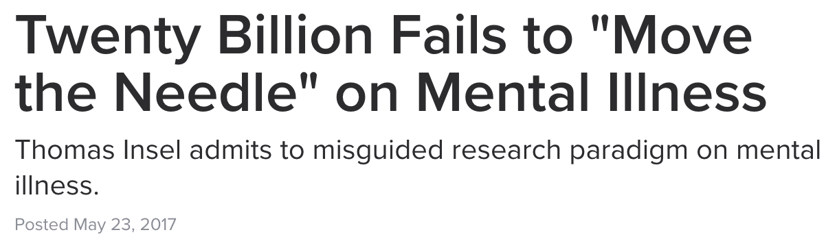
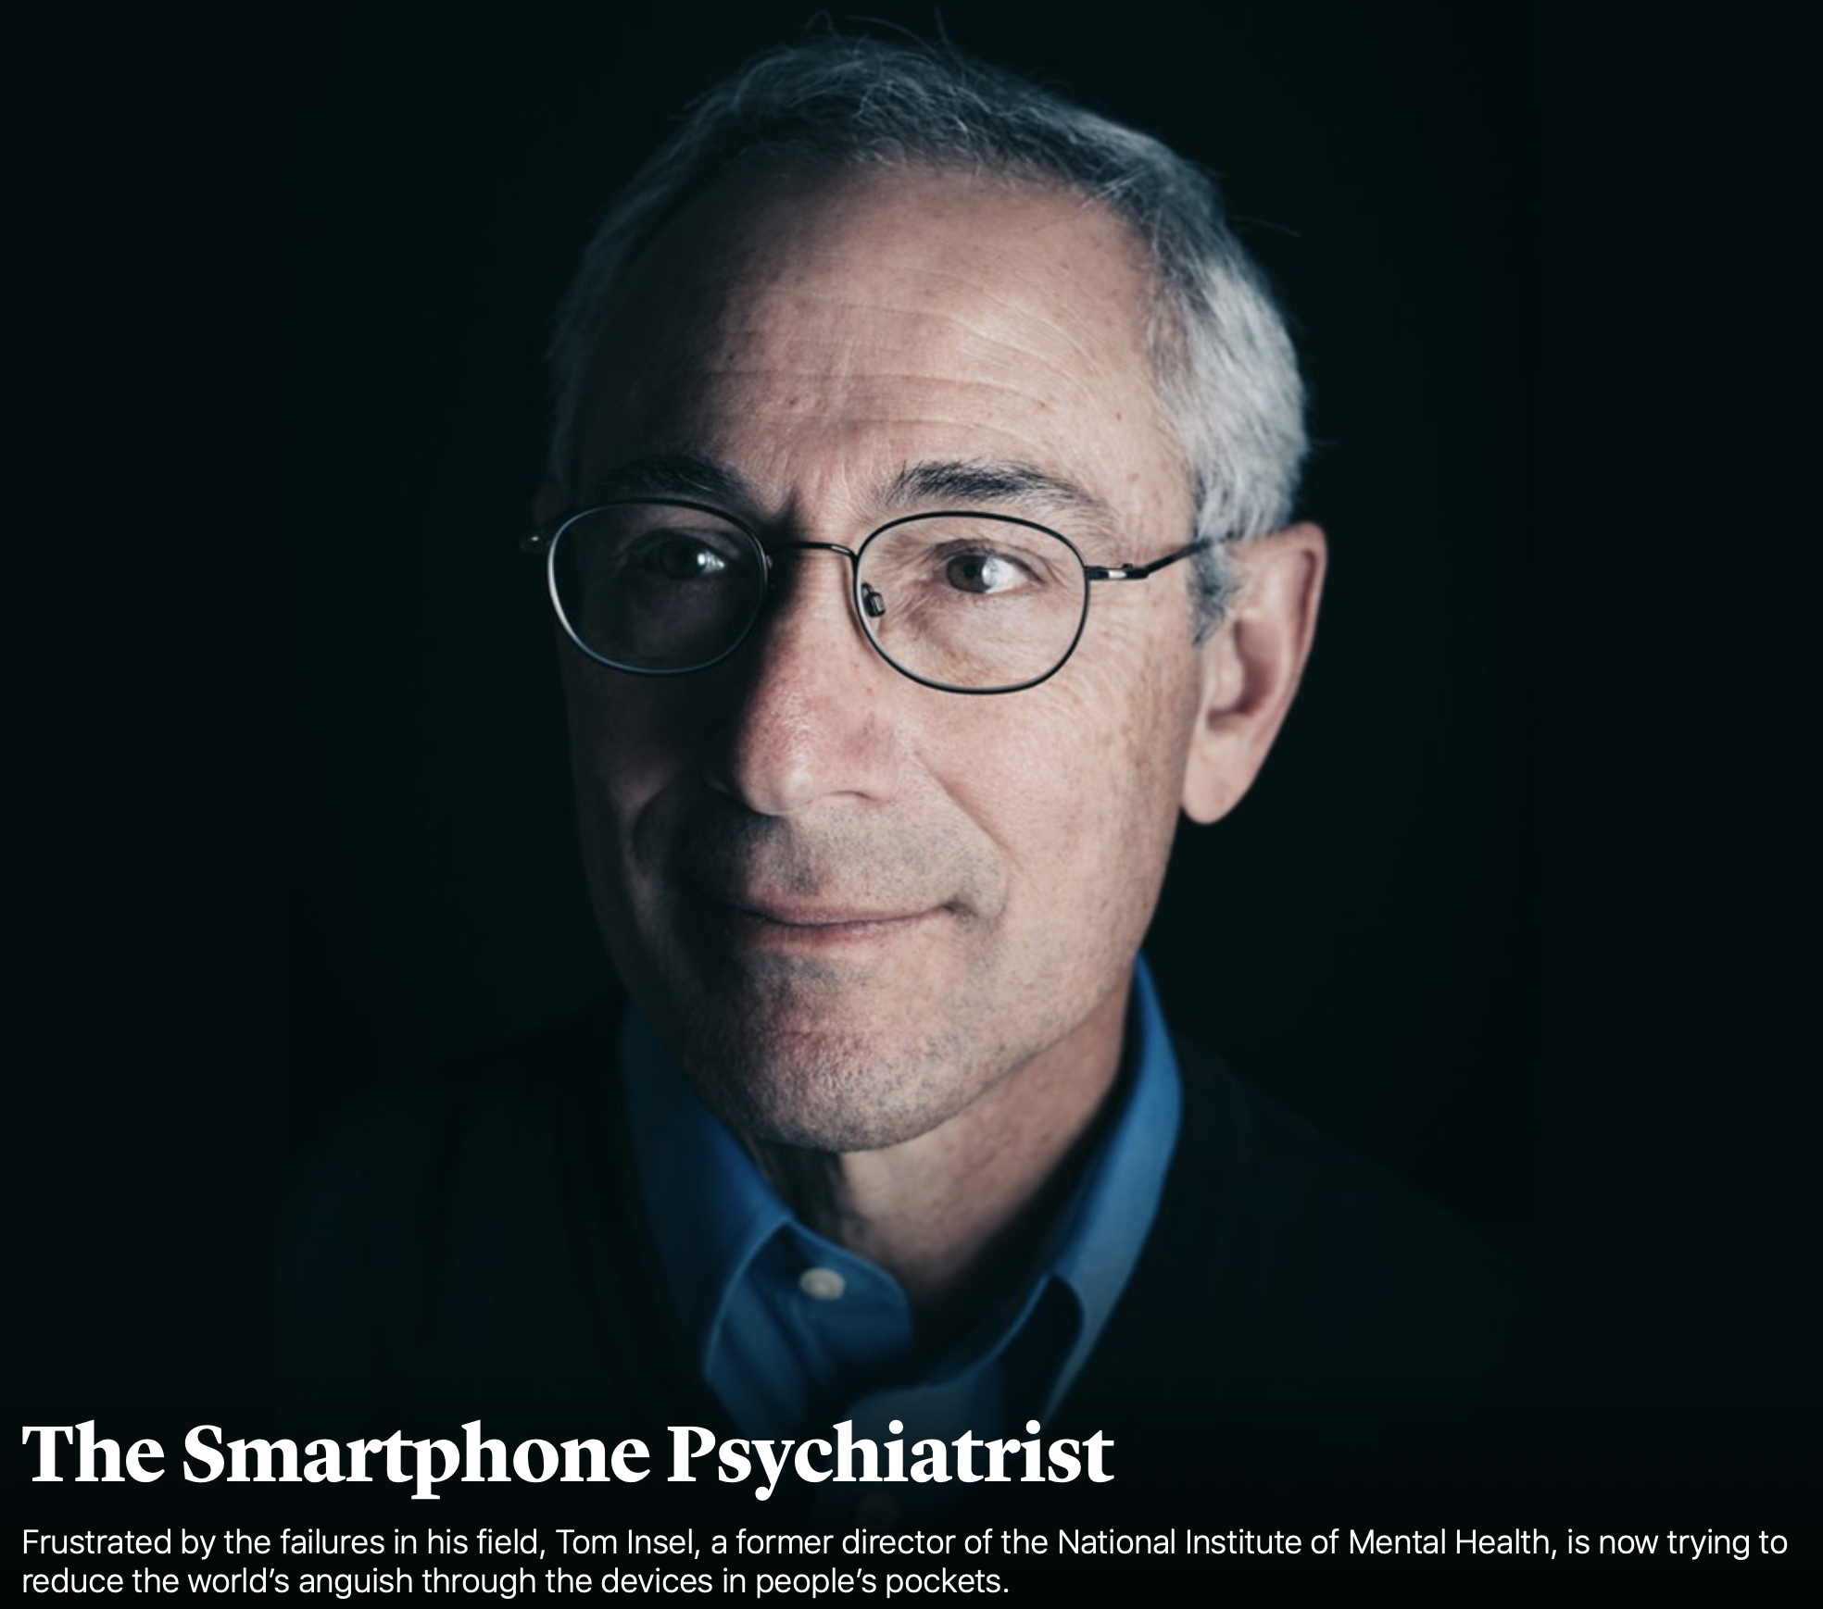
Can we change brains? Research
“I spent 13 years at NIMH really pushing on the neuroscience and genetics of mental disorders, and when I look back on that I realize that while I think I succeeded at getting lots of really cool papers published by cool scientists at fairly large costs—I think $20 billion—I don’t think we moved the needle in reducing suicide, reducing hospitalizations, improving recovery for the tens of millions of people who have mental illness.”

Slide 12
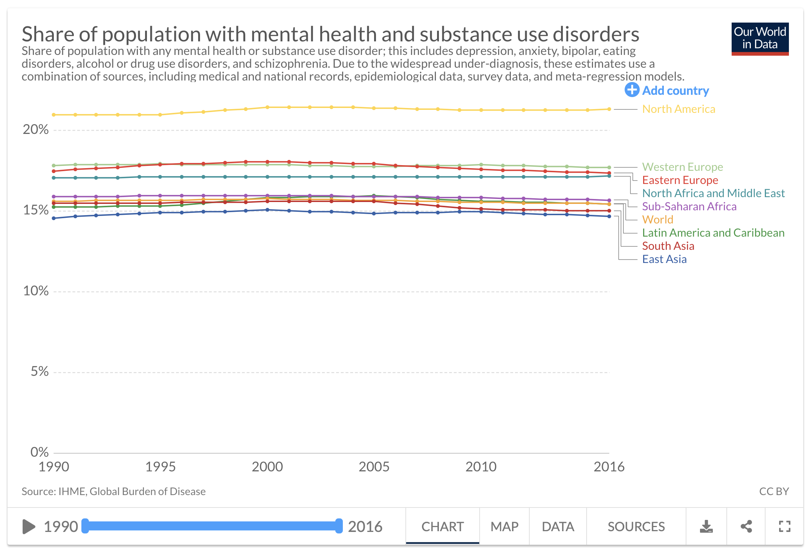
Can we change brains?
Global burden of Mental Health and Substance Abuse
Notes:
This stuff is really important and super boring. It’s not what you got a PhD for and we can help you.

Slide 13
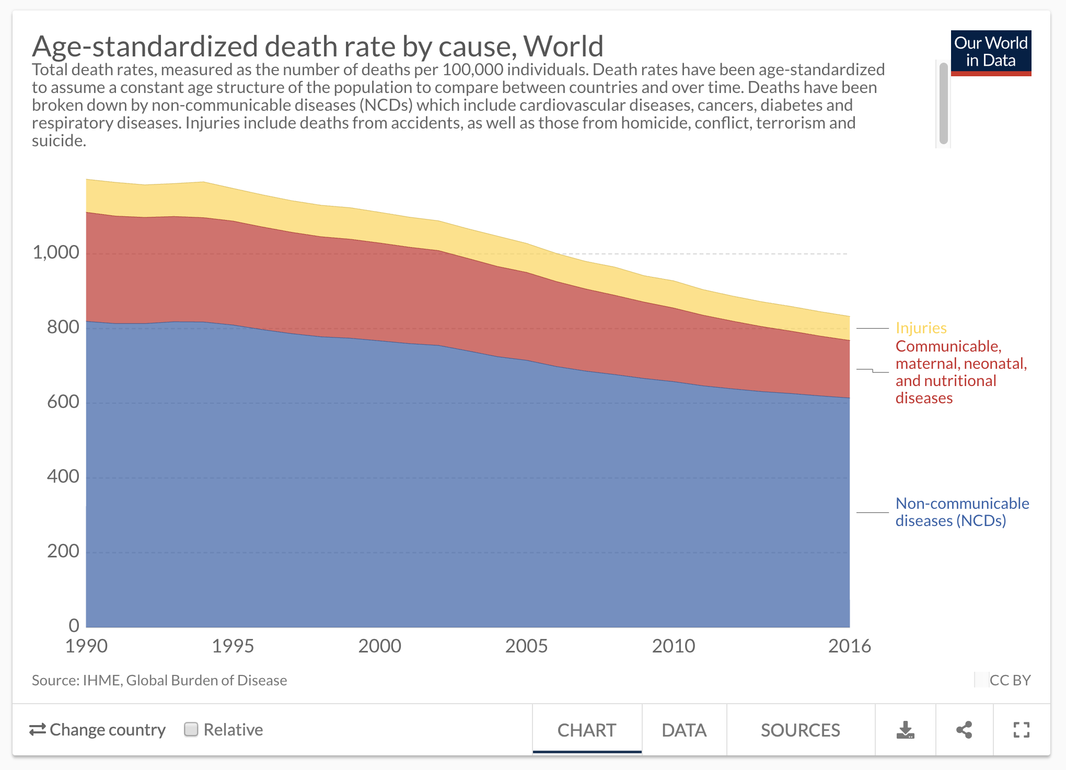
Can we change brains?
Global burden of Mental Health and Substance Abuse
versus all cause mortality
Notes:
This stuff is really important and super boring. It’s not what you got a PhD for and we can help you.

Slide 14
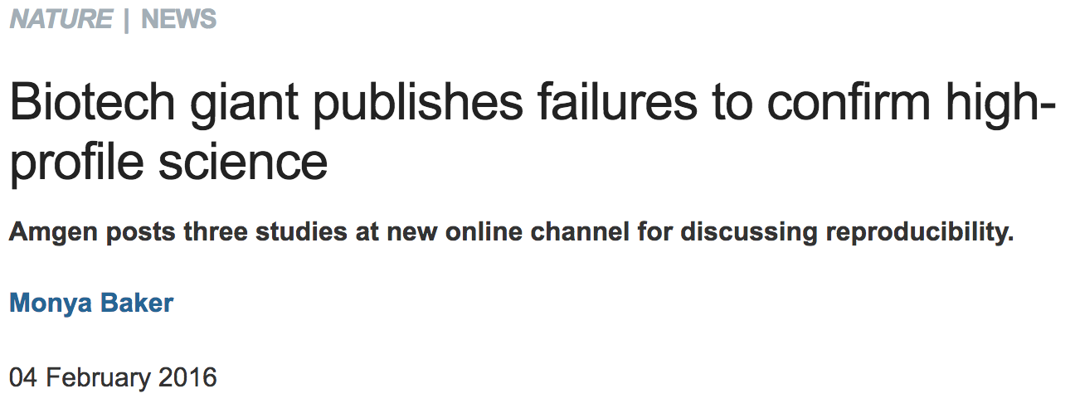
Can we fix brains?
Reproducibility
doi:10.1038/nature.2016.19269
In 2012, Amgen researchers made headlines when they declared that they had been unable to reproduce the findings in 47 of 53 'landmark' cancer papers¹. Those papers were never identified — partly because of confidentiality concerns — and there are no plans to release details
Notes:
This stuff is really important and super boring. It’s not what you got a PhD for and we can help you.

Slide 15
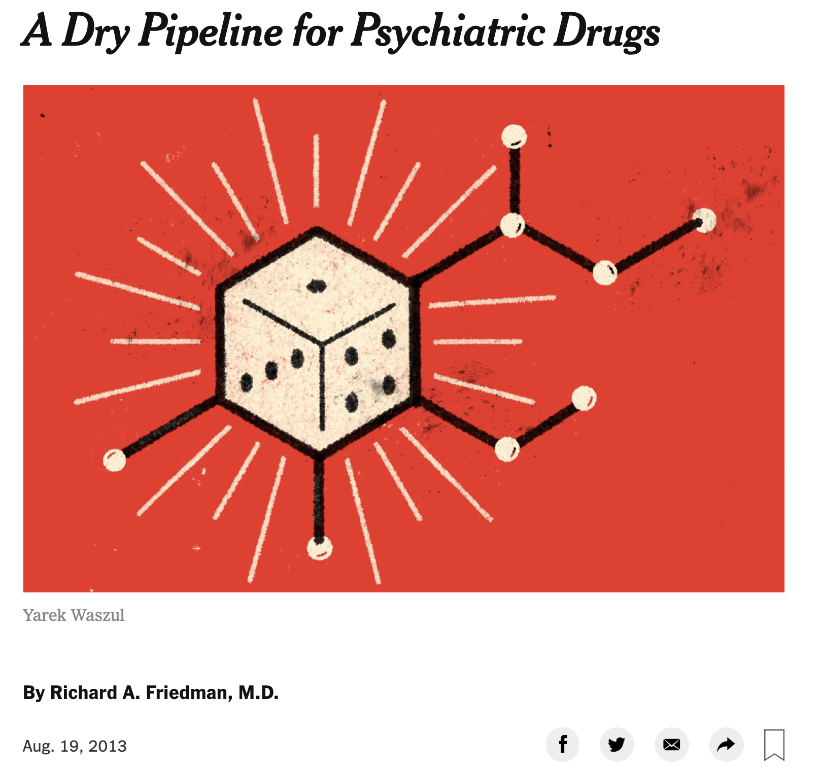
Can we fix brains?
Big Pharma
Also: https://www.newyorker.com/tech/annals-of-technology/the-psychiatric-drug-crisis
Notes:
This stuff is really important and super boring. It’s not what you got a PhD for and we can help you.

Slide 16
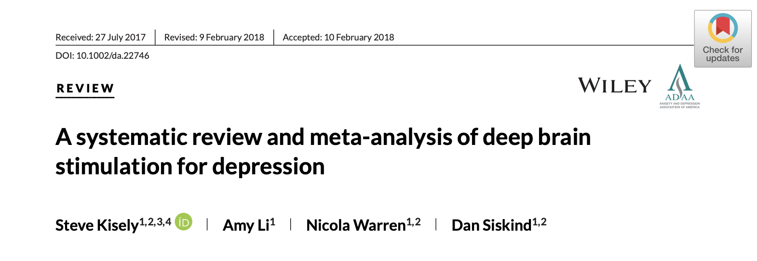
Can we fix brains?
Invasive Stimulation
“Deep Brain Stimulation may show promise for treatment-resistant depression but remains an experimental treatment until further data are available.”
Notes:
This stuff is really important and super boring. It’s not what you got a PhD for and we can help you.

Slide 17
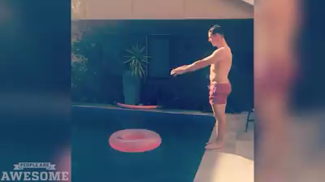
Can we change brains?
clearly
Notes:
.

Slide 18
Outline
Why do you have a brain?
Adaptable and complex movements
Can we change (fix) a brain?
Individually, yes. But no silver bullets and not on a large scale.
How will we fix brains in the future?

Slide 19
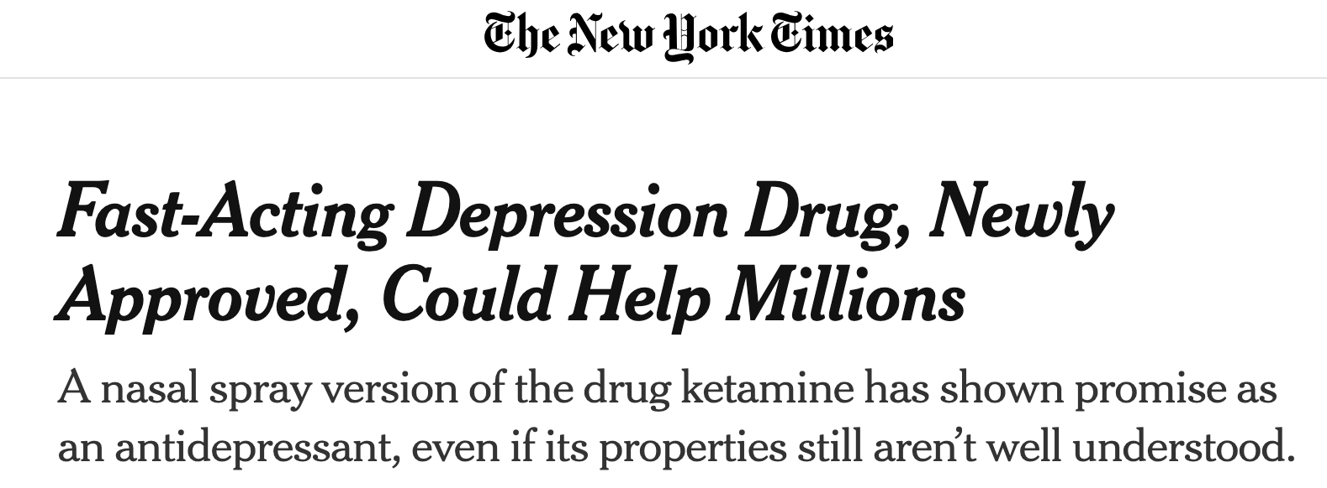
Changing the brain in the future:
New Drugs
Notes:
This stuff is really important and super boring. It’s not what you got a PhD for and we can help you.

Slide 20
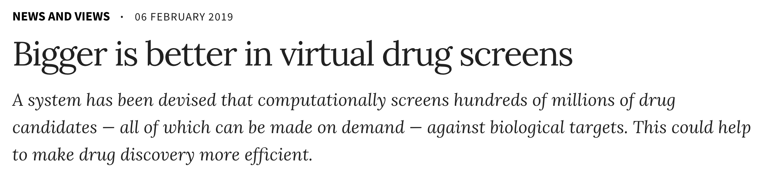
Changing the brain in the future:
New Drugs
Notes:
This stuff is really important and super boring. It’s not what you got a PhD for and we can help you.

Slide 21
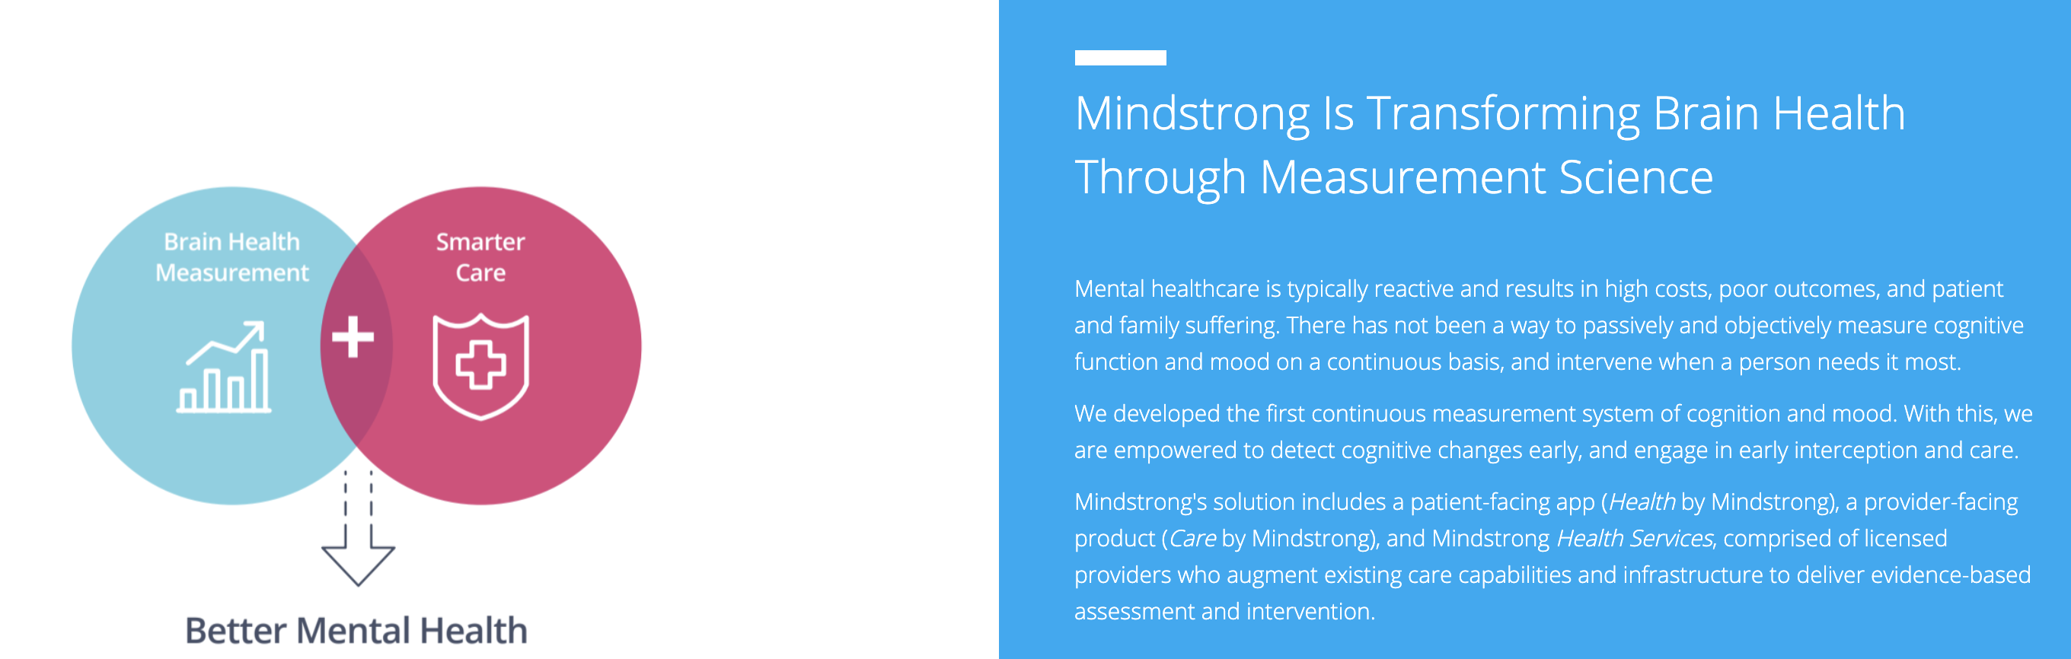
Changing the Brain in the future:
Smartphone Psychiatry
https://www.theatlantic.com/magazine/archive/2017/07/the-smartphone-psychiatrist/
Notes:
This stuff is really important and super boring. It’s not what you got a PhD for and we can help you.

Slide 22
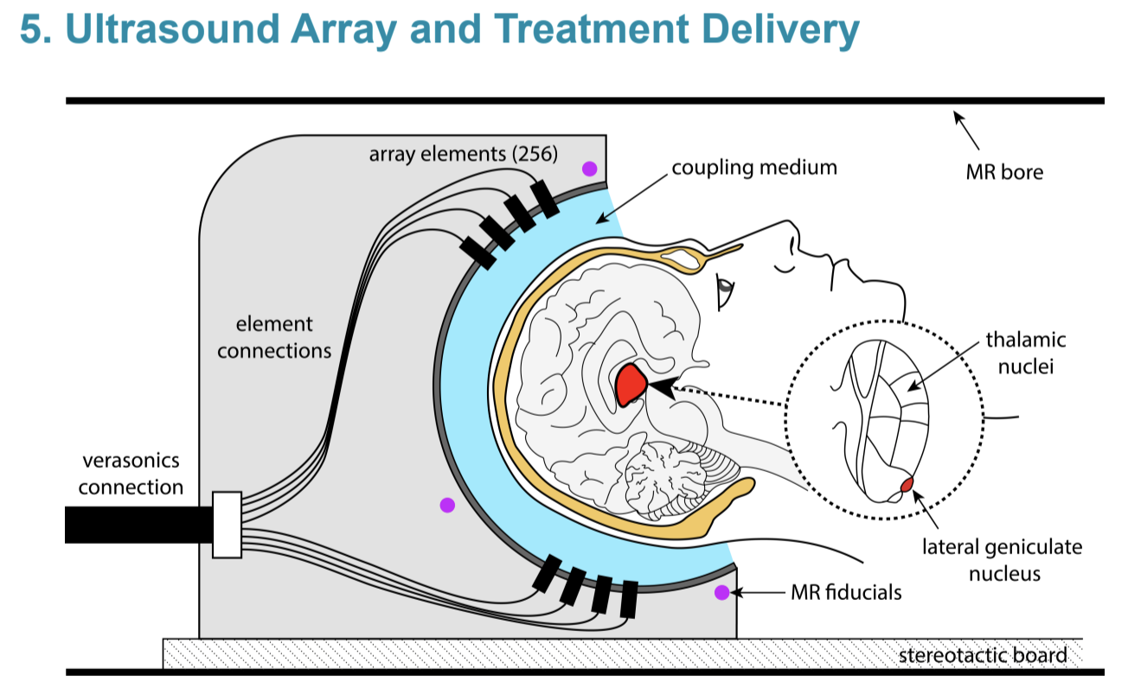
Changing the Brain: the future Noninvasive Stimulation

Slide 23
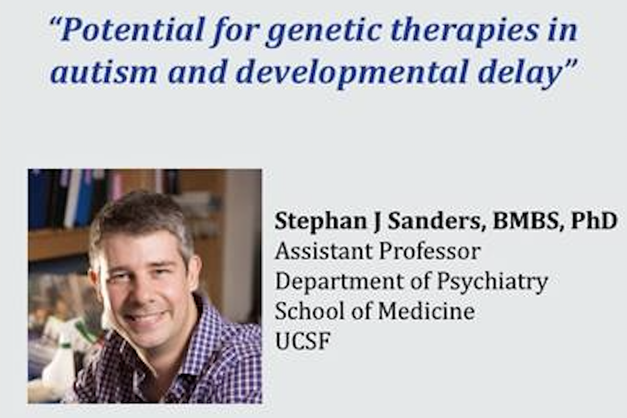
Changing Brain: the future Gene Therapy
https://sanderslab.github.io/team/stephansanders.html doi: 10.1016/j.tins.2018.03.011 https://www.bloomberg.com/news/articles/2019-04-07/gene-therapy-was-hailed-as-a-revolution-then-came-the-bill

Slide 24
Take Homes
Your brain is there so you can move and adapt quickly to your ever changing environment.
Despite its amazing capacity for learning and adaptations, changing brains is hard and we’ve been failing at it for a long time.
There are still promising avenues of changing brains and improving mental health through technologies such as noninvasive brain stimulation, gene therapy, and smart phone assisted therapy.

Slide 25
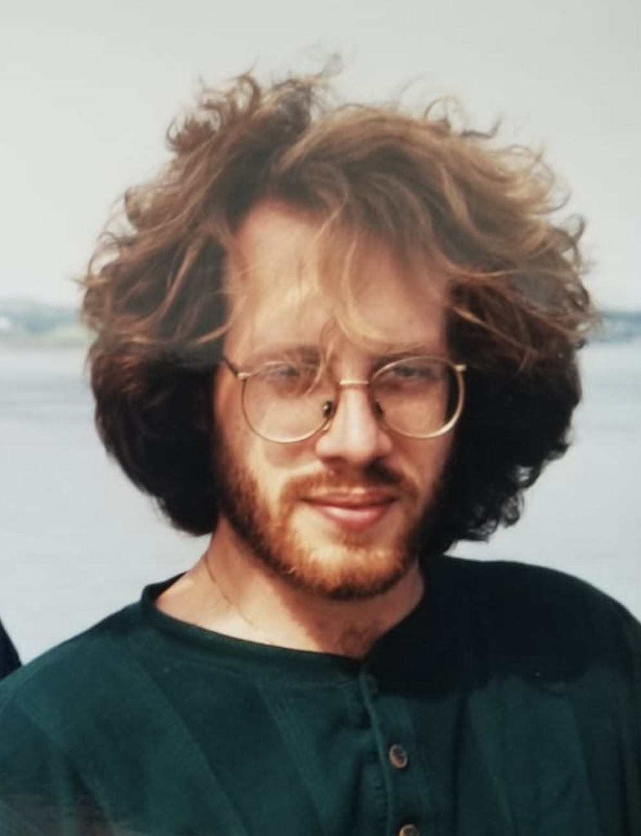
Thanks!

Slide 26
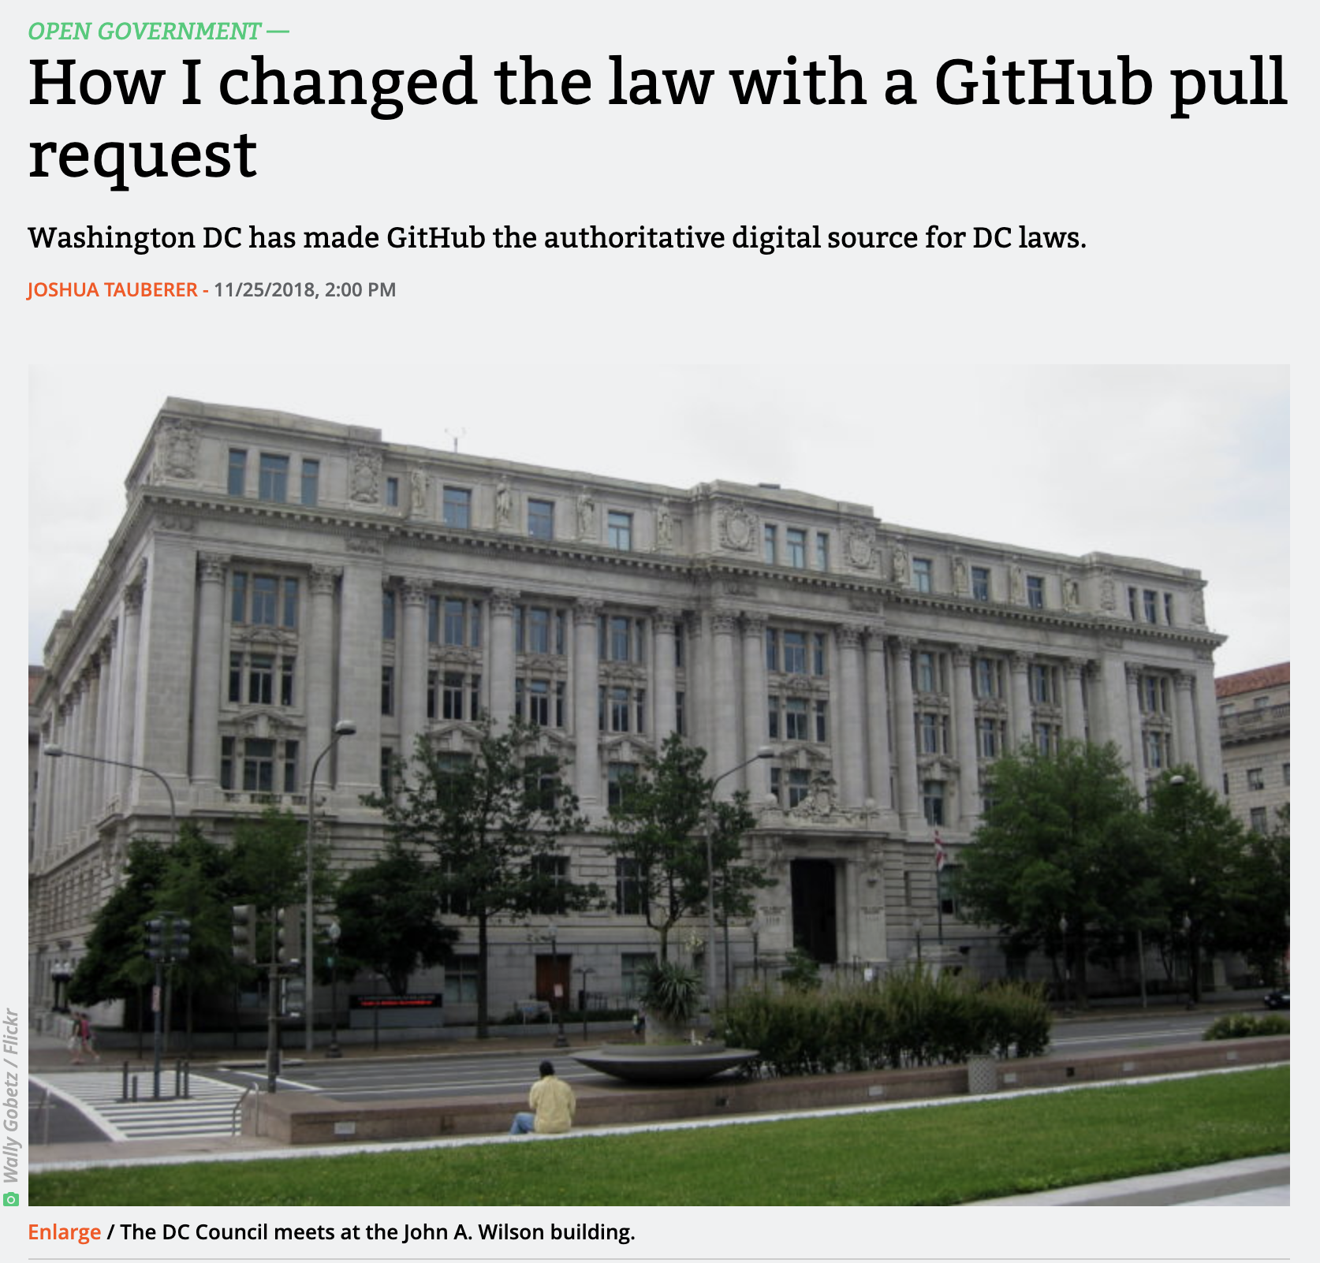
Tracking changes is important in science and the law!
https://arstechnica.com/tech-policy/2018/11/how-i-changed-the-law-with-a-github-pull-request/

